Slide 1

Transition Information Meeting
Year 5

Slide 2

Staff Team
Class Teacher: Miss Newman
Teaching Assistant/s : Mrs Powell (Mon-Tues)
Mrs Mary Baker: Head Teacher
Mrs Lucy Rose: Deputy Head Teacher and SENDCO
Designated Safeguarding Leads:
Mrs Baker, Mrs Rose, Mrs Bunn & Miss Richards
Notes:
Mary Intros – AH Intro
A lot to take in - slides will be on our website

Slide 3
Communication
Please do not feel you have to wait until parents evening if you have any concerns regarding your child. We would encourage you to make an appointment with your child’s class teacher at a mutually convenient time.
Short messages can be passed on in the morning before school.
You can email the class teacher at year5@barfordstpeters.co.uk but please be aware we are teaching during the day and will endeavour to respond within 24 hours.
Updates relating to class activities are regularly posted on twitter - @barfordstpeters and the school website.
To contact Mrs Rose for SEND related queries, please email sendco@barfordstpeters.co.uk
Notes:
Happy children make for good learners and collaborators.

Slide 4

The School Day
Children should arrive at school at 8.30am
Please say goodbye to children on the playground.
Doors will close at 8.45am and children will be marked as late after this time.
Children will be dismissed from the KS2 playground. Each child will be dismissed once the teacher is able to see their designated adult. For safety reasons, please inform the class teacher if a different adult will be collecting your child. Teachers will not dismiss your child to anyone unless they have prior consent.
In Year 6, children may walk home by themselves, however we must receive written permission (emailed is fine) from you before they will be allowed to do so.
Notes:
Wendy

Slide 5

Smartphone free site
We operate a smartphone free site. This means that all children are not permitted to have a smartphone with them at any time whilst on the school site. Any phones that come on to site will be confiscated and parents will be asked to collect them.

Slide 6
Class Timetable
PE days will be: Wednesdays (outdoor) and Fridays (Indoor)
This will be shared with you in September

Slide 7
Homework
Reading
All children should record their reading in their reading diary a minimum of 3 times per week. Teachers will check the reading diary at least once per week.
Weekly completion of one CGP reading task in comprehension books, we will fill any remaining weeks (once the book is completed) with 60-second reads.
Spelling
All children will have an A5 spelling book. Spellings will be put into the book weekly. Children can practise their spellings by writing them in their book.
Maths
All children will have a Schofield and Simms maths book (Sections A, B, C unless directed otherwise by class teacher)

Slide 8
Books To Read Before You Leave Year 5
There are 6 books for each year group (one per half term).
When your child has read a book, they will come and see Mrs Baker to be quizzed on what they’ve read. If they can confidently talk about the book they have read, they will get a sticker for their reading record.
Once all 6 books have been read, children will receive a reading pin for their year group. They can collect them each year as they journey through school.
A small number of copies of the books will be available in school for children to take home but, if you want to make a head start over the holidays, these books can be loaned from your local library.
Notes:
Books have been chosen to broaden reading diet. There is a mixture of classic texts, poetry, modern texts and non-fiction texts too. Hopefully something for everyone!
Show parents an example of what the front of the reading records will look like.
Remind parents that they can loan books from the library or buy them for their own book collection.

Slide 9

6 Books You Should Read Before You Leave:
Year 5
Some of these titles may change

Slide 10

Equipment
We have lots of equipment readily available in school for the children should they need it.
In Key Stage 2, children are allowed to bring their own pencil cases, however, we do not want them to be too big and so please can I encourage a sensible size.
Air-up water bottles are not permitted in school.
Children writing in pen must write in blue handwriting pen – no biros please!

Slide 11


Lunchtimes and Snacks
Children can choose to have a hot school dinner (red, green or jacket potato option) or packed lunch. Menus are on the school website.
If your child chooses to have a packed lunch, please try to ensure that it contains a healthy balance. Fizzy drinks are not allowed in school.
Children will only be allowed fruit at breaktimes – no cereal bars, fruit winders etc.

Slide 12
Uniform
WINTER White shirt with school tie (clip on, elasticated or traditional) or White polo shirt; these can be with logo or plain Grey trousers, shorts, pinafore dress or skirt. Red v-neck sweatshirt or jumper or cardigan White or grey socks, grey or red tights Red fleece for outdoor use (optional) Smart black school shoes – TRAINERS are not acceptable. Please avoid shoes with flashing lights as they are distraction to learning. SUMMER Short sleeve white shirt or polo shirt Grey shorts or skirt Red/white striped or checked dress Grey or white socks
Please name everything

Slide 13
Uniform
PE Kit Children will need a school P.E. bag with their name on and: Red shorts White round-neck school t-shirt Black plimsoles In Winter: • Black joggers and a hoodie
In addition, children will need: A school water bottle A school book bag Nail varnish and jewellery (except plain stud earrings or a simple watch) are not permitted. Hair bands and bobbles should be red, black or white – no large bows please
Please name everything!

Slide 14
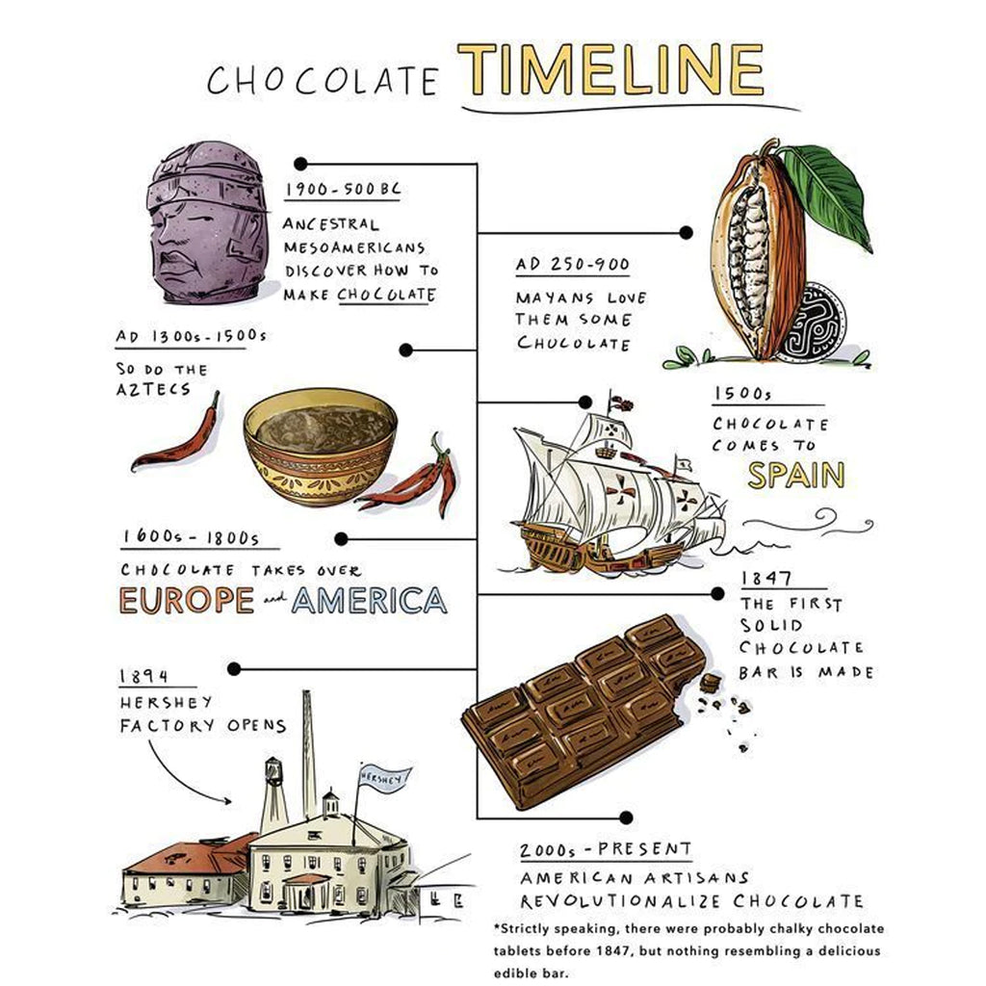

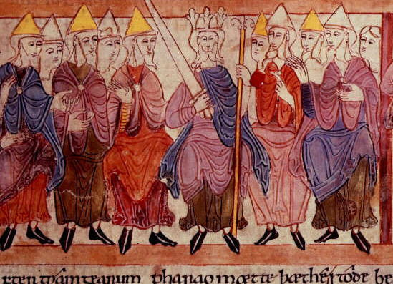
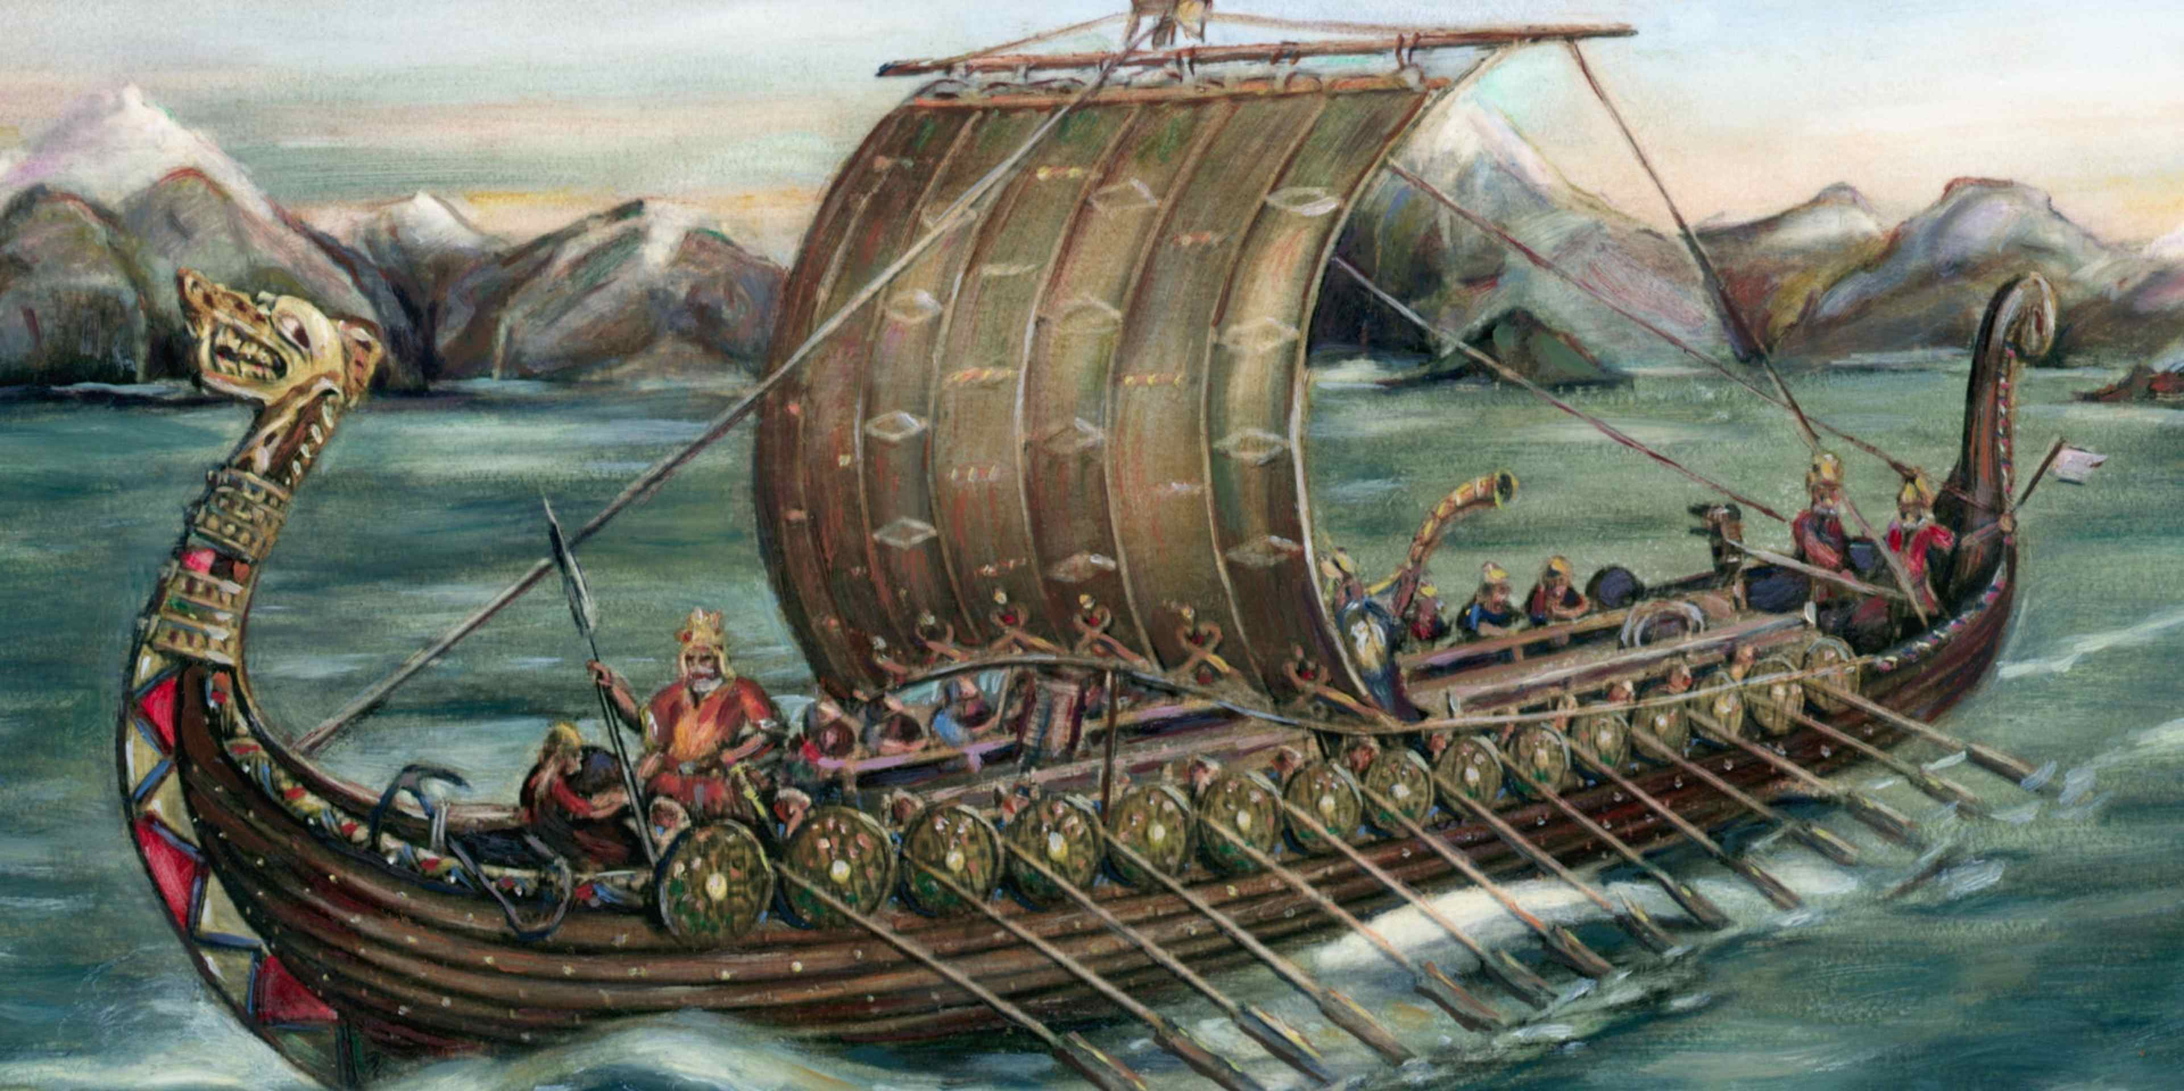
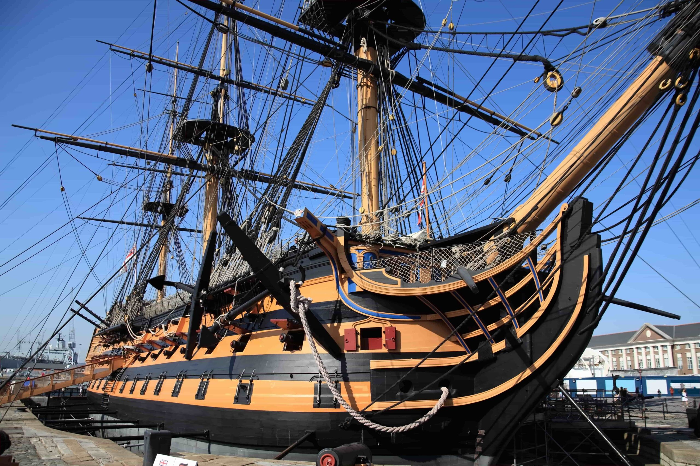
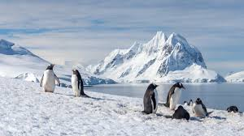
Curriculum Overview
Y5 topics for the year:
Maya and Aztecs
Chocolate
Anglo-Saxons
Vikings
Antarctica
Britain at Sea

Slide 15
Clubs
We have a wealth of different clubs available throughout the year. Examples include:
Choir
Gardening Club
Football
Tennis
Lego
Drawing
First Aid
Look out for information sent out each term to sign up for places

Slide 16
Educational Visits
Lots of exciting visits being planned:
Maya experience day – 18th September
Cadbury world – 7th November
Portsmouth one night residential – 30th April to 1st May
Look out for dates for these other trips/ visits being planned:
Trip linked to Vikings/ Anglo-Saxons
Antarctic Explorer day

Slide 17
Dates for the Diary
Monday 1 September 2025 (Teacher Training Day)
Tuesday 21st & Wednesday 22nd October Parents Meetings
Friday 24th October (Teacher Training Day)
Thursday 27th October Year 5 Autumn Parent Share
Monday 5th January 2026 (Teacher Training Day)
Wednesday 21st January Year 5 Poetry and Music Assembly
Wednesday 11th February Year 5 Spring Parent Share
Wednesday 20th May Year 5 Class Assembly
Monday 15th June Year 5 Summer Parent Share
Monday 1st June 2026 (Teacher Training Day)
Monday 20 July 2026 (Teacher Training Day)
.
Swimming will also be on Tuesdays starting in November – look out for a letter about this closer to the time
Additional dates will be sent to you in the first curriculum letter in September.

Slide 18
Assessments
Children will be assessed throughout each term in reading, writing and maths. This is to enable us to ensure children are making good progress in their learning against their end of year expectations.
Your child’s assessment results will be shared with you at parents’ evenings in October and February. However, if you have any concerns about your child’s progress, you are more than welcome to make an appointment to speak to your child’s class teacher at any time.

Slide 19
Additional Information
Curriculum letters detailing what your child will be learning in each subject will be sent out at the beginning of each half term.
Notes:
Reading diary example.

Slide 20

Questions?

